Slide 1
Employee Data Analysis using Excel
STUDENT NAME: AYISHA SIDDKA.S
REGISTER NO:422200870
DEPARTMENT:IIIB.COM ISM
COLLEGE:SHRI KRISHNASWAMY COLLEGE FOR WOMEN

Slide 2
PROJECT TITLE
TRENDS WITH EXCEL CHARTS

Slide 3


AGENDA
Problem Statement
Project Overview
End Users
Our Solution and Proposition
Dataset Description
Modelling Approach
Results and Discussion
Conclusion
3/21/2024 Annual Review

Slide 4

PROBLEM STATEMENT
1. Identify the Problem Statement
Clearly define the issue or question you want to address with your data.
Example: “Sales have been declining over the past year. What trends can we identify to understand this better?”
2. Collect and Organize Data
Gather the relevant data that pertains to your problem statement.
Example: Monthly sales data, customer feedback scores, etc.
Organize the data in Excel, typically with columns for dates/times and corresponding values.
.

Slide 5

PROJECT OVERVIEW
1. Project Title
Analyzing Sales Trends Using Excel Charts
2. Objectives
To visualize and identify trends in sales data over a specified period using Excel charts.
To provide actionable insights and recommendations based on the identified trends.
3. Problem Statement
Sales have shown variability over recent months, and there is a need to understand the underlying trends to make informed business decisions.
.

Slide 6

WHO ARE THE END USERS?
1. Objectives
To use Excel charts to visualize and identify trends in data.
To enable end users to interpret trends and make data-driven decisions based on their findings.
2. Problem Statement
End users need to analyze their data to understand trends and patterns but may not be familiar with advanced data analysis techniques.
3. Scope
Data Type: Sales, performance metrics, or other relevant datasets.
Chart Types: Line charts, bar charts, pie charts, and scatter plots.
Focus: Understanding overall trends, seasonal variations, and patterns

Slide 7

OUR SOLUTION AND ITS VALUE PROPOSITION
1. Solution Overview
Our solution focuses on enabling users to efficiently analyze and interpret trends using Excel charts. We provide a structured approach that simplifies data visualization and trend analysis, empowering users to make data-driven decisions with ease.
2. Key Features and Benefits
A. Comprehensive Data Visualization
Line Charts: Ideal for tracking changes over time, revealing long-term trends and seasonal variations.
Bar/Column Charts: Effective for comparing different categories or time periods, highlighting relative performance.
Pie Charts: Useful for showing proportions and percentages, making it easy to see how different parts contribute to the whole.
Scatter Plots: Helps in identifying relationships between variables, useful for correlation analysis.

Slide 8
Dataset Description
1. Dataset Overview
Title: Monthly Sales Data for 2023
Purpose: To analyze trends in sales performance over the year, identify seasonal patterns, and assess any significant changes.
2. Data Components
A. Columns (Fields):
Date/Month:
Description: The time period for the data, typically formatted as month and year.
Format: Date format (e.g., "Jan 2023", "02/2023").
Example: January 2023, February 2023.
Sales Amount:
Description: Total sales revenue for the corresponding month.
Format: Currency format (e.g., USD, EUR).
Example: $10,000, €8,500.
Sales Channel (Optional):
Description: The channel through which sales were made (e.g., Online, In-Store).
Format: Text or categorical data.
Example: Online, In-Store.

Slide 9

THE "WOW" IN OUR SOLUTION
1. Interactive and Dynamic Dashboards
A. Custom Dashboards:
Description: Create interactive dashboards that consolidate multiple charts and data points into a single view.
Features:
Dynamic Filters: Use slicers and drop-down menus to allow users to filter data by date, sales channel, region, or customer segment.
Interactive Charts: Implement charts that update automatically based on user selections or filters.
B. Real-Time Data Integration:
Description: Connect Excel to live data sources for real-time trend analysis.
Features:
Power Query: Automate data updates and refresh charts with live data.
Power BI Integration: Integrate with Power BI for advanced visualizations and real-time reporting.
3/21/2024 Annual Review
9

Slide 10
MODELLING
1. Define Objectives and Hypotheses
A. Objectives:
Identify Trends: Understand the overall direction and pattern of data over time.
Analyze Seasonality: Detect recurring patterns or seasonal effects.
Forecast Future Values: Predict future trends based on historical data.
B. Hypotheses:
Develop initial hypotheses about the data, such as whether sales increase in certain months or whether a specific factor affects trends.
2. Prepare Your Data
A. Data Collection:
Gather and organize relevant data in Excel. Ensure data is clean and formatted correctly.
10

Slide 11
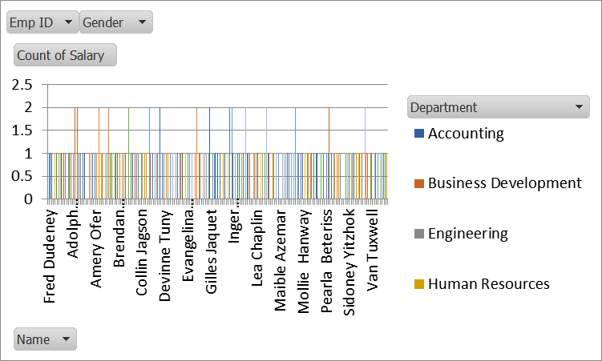
RESULTS
11

Slide 12
conclusion
1. Effective Visualization
Excel charts provide a variety of visualization options, including line charts, bar charts, scatter plots, and combination charts. These tools help transform raw data into meaningful visual representations that make it easier to understand and communicate trends. The ability to visually track data over time or across categories simplifies complex analyses and highlights significant patterns.
2. Enhanced Data Analysis
By incorporating analytical elements such as trendlines, moving averages, and forecasting, Excel charts enable users to delve deeper into their data. Trendlines help identify the overall direction of data, moving averages smooth out fluctuations, and forecasting tools predict future trends based on historical patterns. These features enhance the depth of analysis and provide actionable insights.

